Slide 1
1
Capstone Project:
Predicting University Closures
William Dolan, Billy Doyle, Elisabeth Gangwer, Jason Marchese, Ella Sandt
Notes:
Billy

Slide 2
Presentation Roadmap
1
4
Problem Statement
Model 1
2
5
Data
Model 2
2
3
6
Process
Implications
Our Process
Problem Statement
Model 2
03
05
01
06
02
04
Analysis
The Data
Model 1
Notes:
Billy
So today, we are going to start off by outlining who Huntington Bank are, as well as their interest in the Higher Education sector
We will then also outline the IPEDS database where we gathered our data from
This will then allow us to explain our two models we used to overcome our problem, one outlining a school’s risk of closure, and the other model outlining a schools risk urgency
Finally, we will also go into our exploratory data analysis a bit, identifying which factors are most consequential to a schools overall risk level

Slide 3




Fortune 500 Company
Operations
Customers-First
1,000+ Full Service Branches Across 11 States
11 Private Client Group Offices
16,000 ATM Locations
Empowering Customers with a “Can-Do” Spirit
Driven by Service, Built on Trust
Always look ahead to be the very best
A legacy of Trust & Growth since 1866
Ranked Among the Fortune 500
Managing over $204 Billion in Assets
3
Huntington Bank
“Your Trusted Partner in Banking.”
Founded in 1866
Legacy of trust & growth
Fortune 500 Company, managing over $204 billion in assets
Customers First
Driven by service, built on trust
Huntington is focused on people with a service-oriented heart
Every Step, Every Stage
Huntington serves a wide range of customers, from students opening their first account to corporate finances.
Notes:
Elisabeth
Huntington serves a diverse customer base from students, families, businesses, and importantly for our project: educational institutions.
With Huntington’s commitment to supporting educational institutions, which this project directly aligns with
By using institutional data, we hope to help Huntington better understand early warning signs of institutional distress and offer strategic financial support before these issues become irreversible. So Huntington can step in as a trusted partner, offering solutions before a closure becomes inevitable.
Image from https://www.freep.com/story/money/business/michigan/2022/09/21/huntington-tower-in-detroit-officially-opens/69506967007/

Slide 4




4
Problem Statement
US College closures are expected to “soar” in coming years due to enrollment and demographic challenges.
Goal: Build a model to identify institutions at risk of closing within the next 2 - 4 years
Perform Exploratory Data Analysis
Feature Selection & Variable Importance
Develop Predictive Model
Insights & Key Findings
Utilize multi-year data to develop a model to predict institutional failure/bankruptcy
Understand trends and patterns in the data.
Determine the most influential factors linked to school closures.
Allow Huntington to understand what makes an institution at risk of closing
Notes:
Ella
Now diving into the objective of this project… college closures are expected to soar in upcoming years
Our goal was to build a model that could identify these institutions that were of risk of closing within 2-4 years
Now for a little overview of our process
We needed to perform an exploratory analysis of our data
Feature selection to identify which factors were influential in schools closure
Then build our model
Derive insights for Huntington to have more understanding about the institutions that are closing

Slide 5


Data
(IPEDS) - National Center for Education Statistics’ Integrated Postsecondary Education Data System
Collected from American institutions of higher education since 1980.
Focused on 2015-2023
12 Interrelated Survey Components
Challenges with Data
5
IPEDS
National Center for Education Statistics’ Integrated Postsecondary Education Data System
Data Collection
2015 - 2023 data from 12 interrelated survey components
Not-for-Profit and Public Institutions
Challenges with Data
Inconsistent reporting
Changing school IDs
** Note for Huntington Team
Notes:
Elisabeth
We sourced our data from the IPEDS system, which is maintained by the National Center for Education Statistics.
IPEDS is a public resource and has been collecting data on U.S. colleges and universities since 1980, covering a wide range of information on the institution including institutional characteristics, financials, student aid, and enrollment.
While the historical depth of the dataset is valuable, we chose to narrow down our data to the 2015 - 2023 Academic Years. We believe that including just the more recent years reflect the financial and structural conditions most relevant to our project. Data from 1980 on an institution that closed is going to look different from an institution that closed within the past 8 years.
We pulled data from 12 interrelated survey components, focusing on public and not-for-profit institutions
For-Profit Institutions made up a large portion of the data but often represent technical, beauty, and trade schools, which we ultimately decided to remove as they were not Huntington’s target audience
If Huntington is going to utilize the IPEDS data there may be some data challenges to be aware of
Inconsistent reporting: Not all schools submit data uniformly each year, especially private schools where reporting is often optional. Which led to a high proportion of missing data in our dataset.
Changing Unit IDs: When institutions merge or reorganize, their identifiers change, complicating long term tracking.

Slide 6
12 Survey Components
6
01
Institutional Characteristics
02
12 - Month Enrollment
03
Admissions and Test Scores
Institutional Characteristics | Employees by Position
12-Month Enrollment | Student Aid Financel & Net Price
Admissions and Test Scores | Graduation Rates
Fall Enrollment | Outcome Measures
Staff Salaries | Academic Libraries
Fall Staff | Completions
04
Fall Enrollment
05
Completions
06
Staff Salaries
07
Fall Staff
08
Employees by Position
01
09
Student Aid Financial & Net Price
10
Graduation Rates
11
Outcome Measures
12
Academic Libraries
Notes:
Ella
These are the 12 survey components that Elisabeth just mentioned, …
things like enrollment, admissions, salaries, and financial aid.
Gives a really comprehensive picture of all these institutions

Slide 7
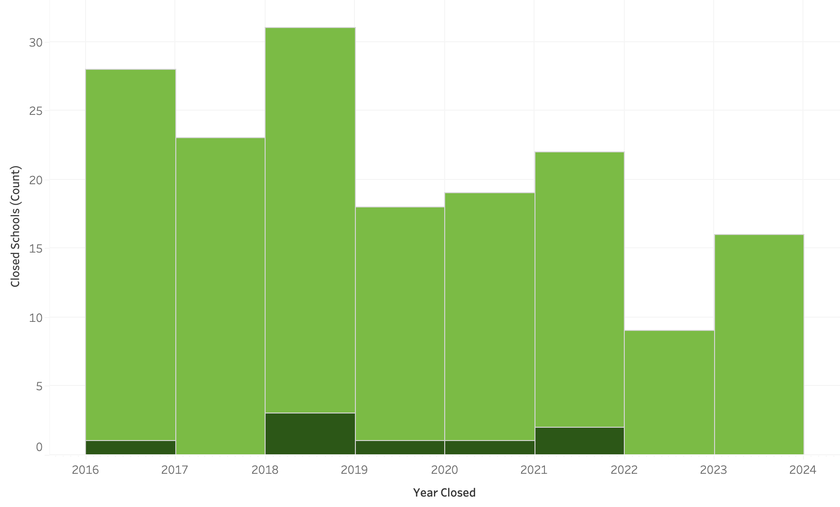
Institutions Closed Academic 2015-2023
168
8
160
8
7
Total Institutions Closed
Public Institutions
NonProfit Institutions
Non-Profit Institutions
Public Institutions
Public
Non-Profit
Notes:
Ella
To give context of the growing issue, this is a graph showing the institutions that have closed from academic year of 2015-2023. The dark green is public schools and the light green is non profit schools
In this time frame, 168 institutions have closed
160 were non profit and only 8 were public
This highlights a pattern hat nonprofits are much more at risk

Slide 8



Process
8
Define Target Variable
Select Key Features
Data Preparation
‘Y2C’ → Years to Closure: The difference between the year the data was reported and the year the school closed
Notes:
Elisabeth
We originally started with multiple datasets for each year, containing hundreds of features with different datasets for each survey component.
We created our target variable, ‘Y2C’ (Years to Closure), by calculating the difference between the year the data was reported and the actual closure year of the institution. This value was then later categorized to support modeling based on proximity to an institutions closure.
From there, we ran feature selection on the 12 survey components, prioritizing variables with high predictive value to identify which variables were most relevant.
All selected features were merged into one dataset, ensuring consistency across timeframes and schools.

Slide 9
School Risk Warning Model
9
Define Response Variable
Train XGBoost Model
Prediction
Closed = 1, if the school is within 2-4 years of closure
Closed = 0, otherwise
Binary logistic model trained on 68 variables collected
70/30 split
Assign each school a risk category indicating likelihood of closure
XGBoost regression model to identify the probability of each school to close within 2-4 years
Notes:
Will
As previously discussed, the business objective of our project was to predict the likelihood of a school closure within a relatively short time frame—early enough to allow for meaningful intervention by Huntington. To achieve this, we defined our target variable as a binary indicator of whether a school would close within a 2 to 4-year window. For example if the Years to Close variable was 2,3, or 4 the closed variable would be set to 1 otherwise it would be 0.
We deployed an XGBoost logistic regression model to generate a closure probability score for each institution. Utilizing publicly available IPEDS data, we conducted multiple rounds of variable selection and finalized a set of 68 variables for the model. The dataset was split into a 70/30 ratio for training and testing purposes.
Given the nature of this problem as a multiclass classification, we established threshold cut points to segment the schools into four distinct risk categories. So it’s easy to identify each schools relative risk.

Slide 10
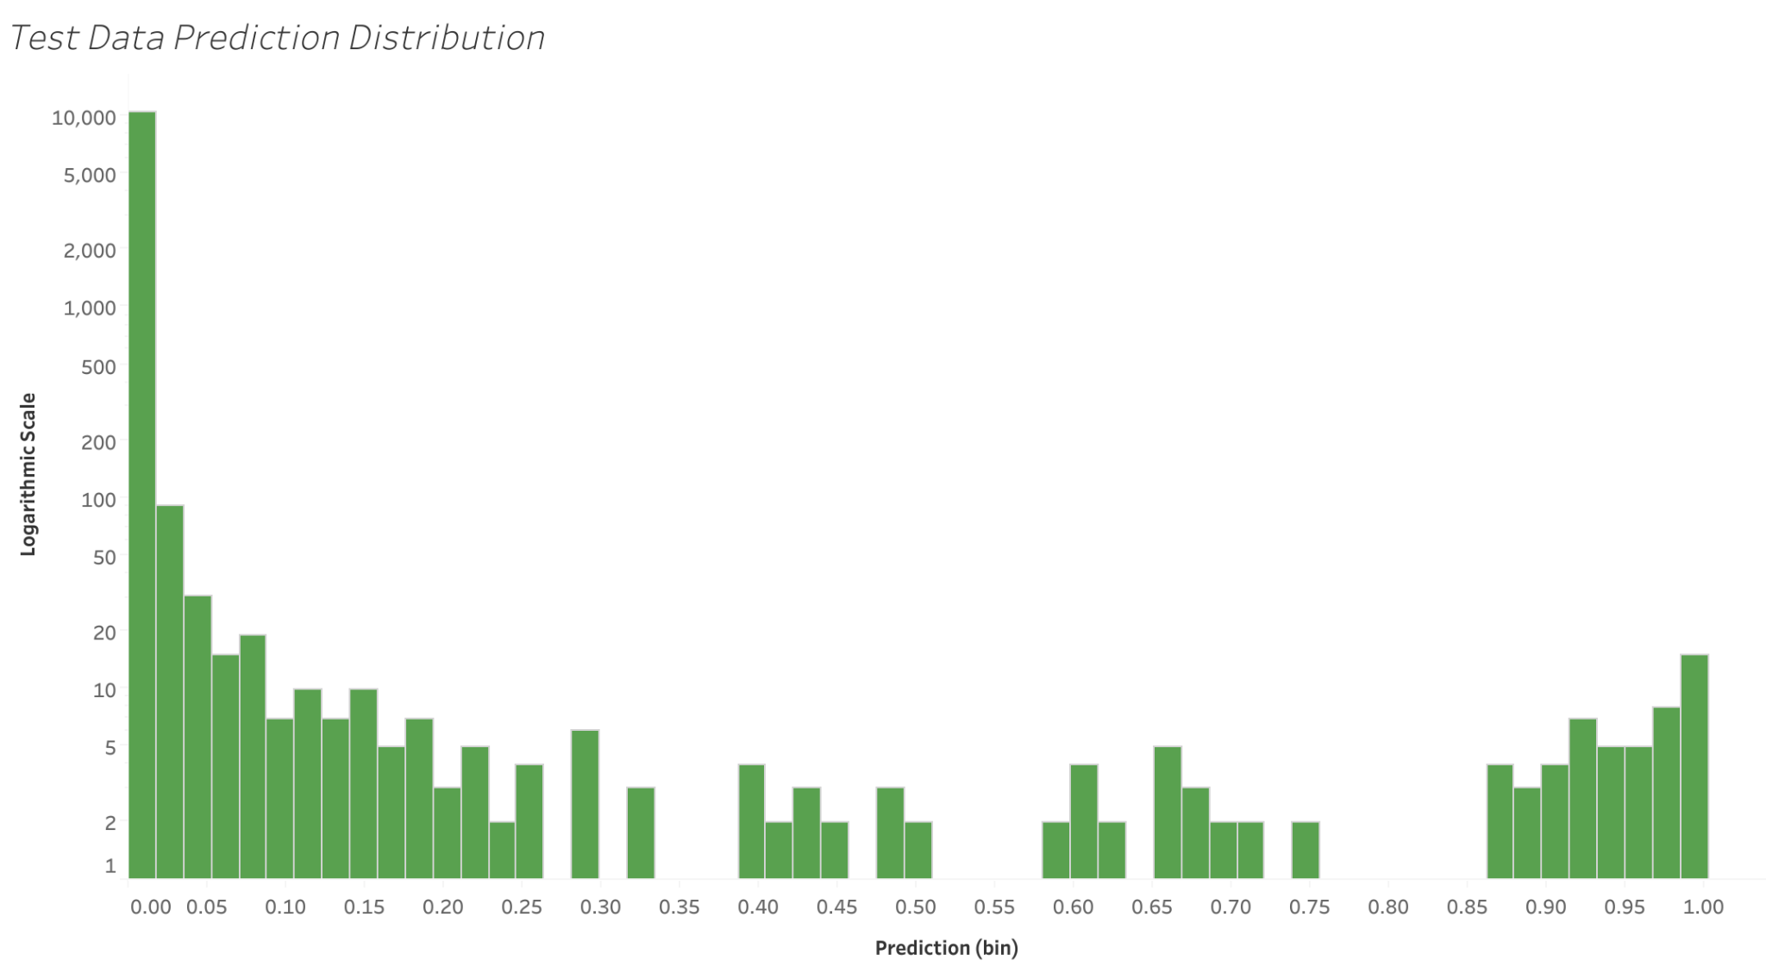
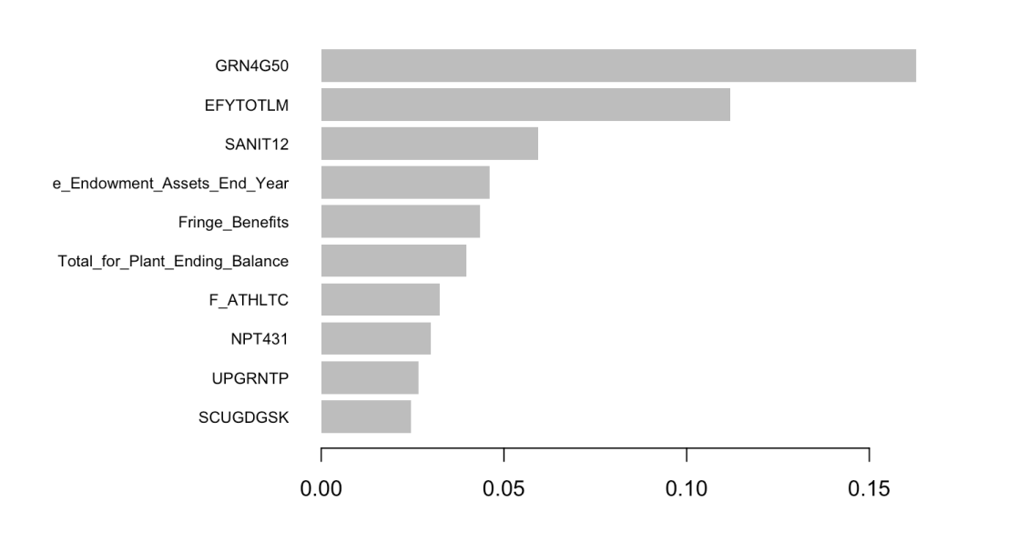
School Risk Warning Model Results
10
GRN4G50 - Number awarded grant and scholarship aid, income level (110,001 or more), for past 2 years
EFYTOTLM - Enrollment for male students in fall term
SANIT12 - Office and Administrative Support - number
Value of endowment assets at the end of the fiscal year
Total expenses and deductions - Employee fringe benefits
Total for plant, property and equipment - Ending balance
F_ATHLTC - Participates in intercollegiate athletics
NPT431 - Average net price (income 48,001-75,000)-students awarded Title IV federal financial aid, 2021-22
UPGRNTP- Percent of undergraduate students awarded Federal Pell grants
SCUGDGSK- Total number of degree/certificate-seeking undergraduate students
95.9%
Prediction Distribution
Balanced
Accuracy
*Log Scale
Heavy bias towards low predictions
Top Variables:
Scholarships provided to higher income families (GRN4G50)
3x more important than the 4th most important variable
Total Enrollment of Male Students in Fall Term (EFYTOTLM)
Significantly more important than the following variables
Notes:
Elisabeth
With the xgboost model, we were able to achieve strong values regarding accuracy with a balanced accuracy of 95.9%
We also extracted the prediction distribution, where there is heavy bias towards low predictions
What you see here is the prediction distribution on the test data, displayed on a log scale.
Heavy skew toward low predictions, meaning most schools are being classified as low-risk.
We also examined the top contributing variables
Scholarships provided to higher-income families, which was over three times more predictive than the fourth-ranked variable endowment value.
Total enrollment of male students, which also stood out as significantly impactful.

Slide 11
Risk Level Classification
11
> 0.97
Institutions at High Risk of Closure (0.21%)
> 0.20
Institutions at Moderate Risk of Closure (0.92%)
> 0.008
Institutions at Low Risk of Closure (3.66%)
< 0.008
Institutions at No Risk of Closure (95.21%)
Notes:
*Will*
Here you can see our cut points, derived from each school's predicted probability of closure, which form the basis for our risk classification framework. Our dataset was extremely unbalanced, given the rarity of school closures, so we prioritized accuracy over equal distribution among the buckets. And one the next side you will see the distiburions for each risk class.

Slide 12
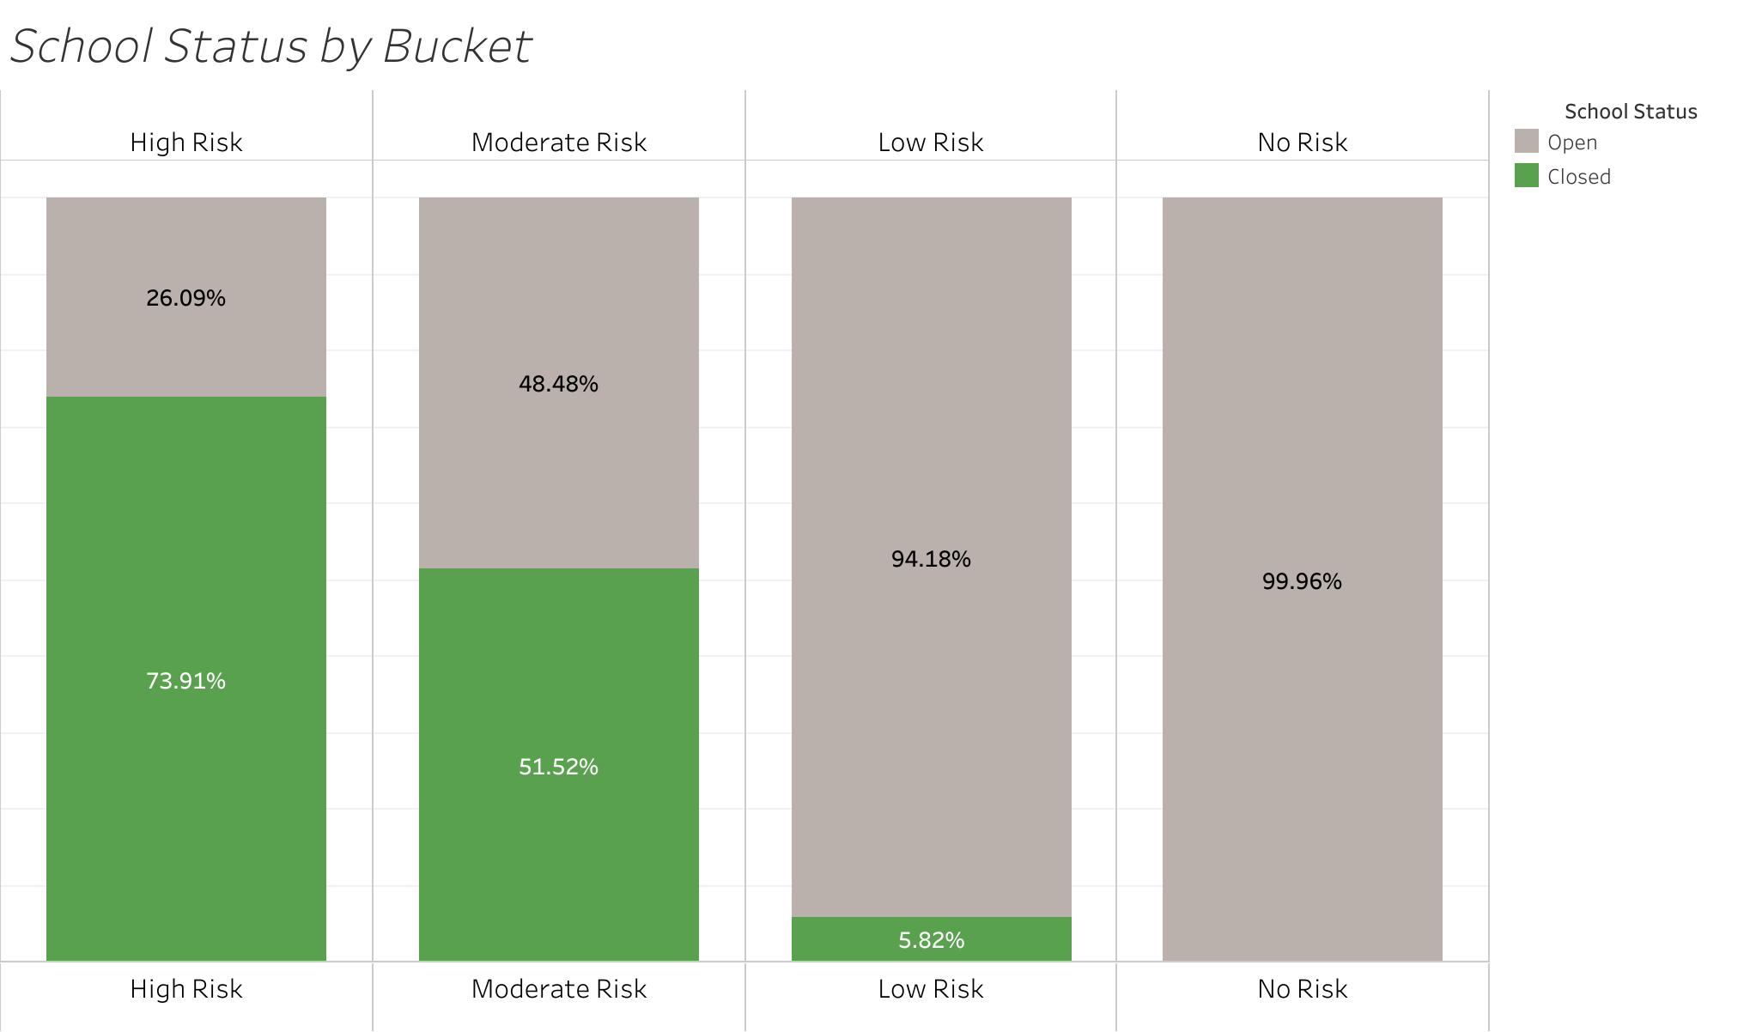
Risk Level Classification
12
0.97
Moderate Risk
0.008
No Risk
High Risk
Low Risk
0.20
Notes:
Will
This chart illustrates the relative distribution across our four risk buckets.
The green bars represent the percentage of schools in each category that ultimately closed within our 2–4 year time horizon. Nearly 75% of institutions classified as high risk did, in fact, close within that period. Schools identified as moderate risk face a greater than 50% likelihood of closure, while the risk sharply declines in the lower categories, becoming virtually zero in the no risk group.
These risk classifications offer a practical tool for identifying institutions that may require proactive support, as well as those that appear to be more stable.

Slide 13
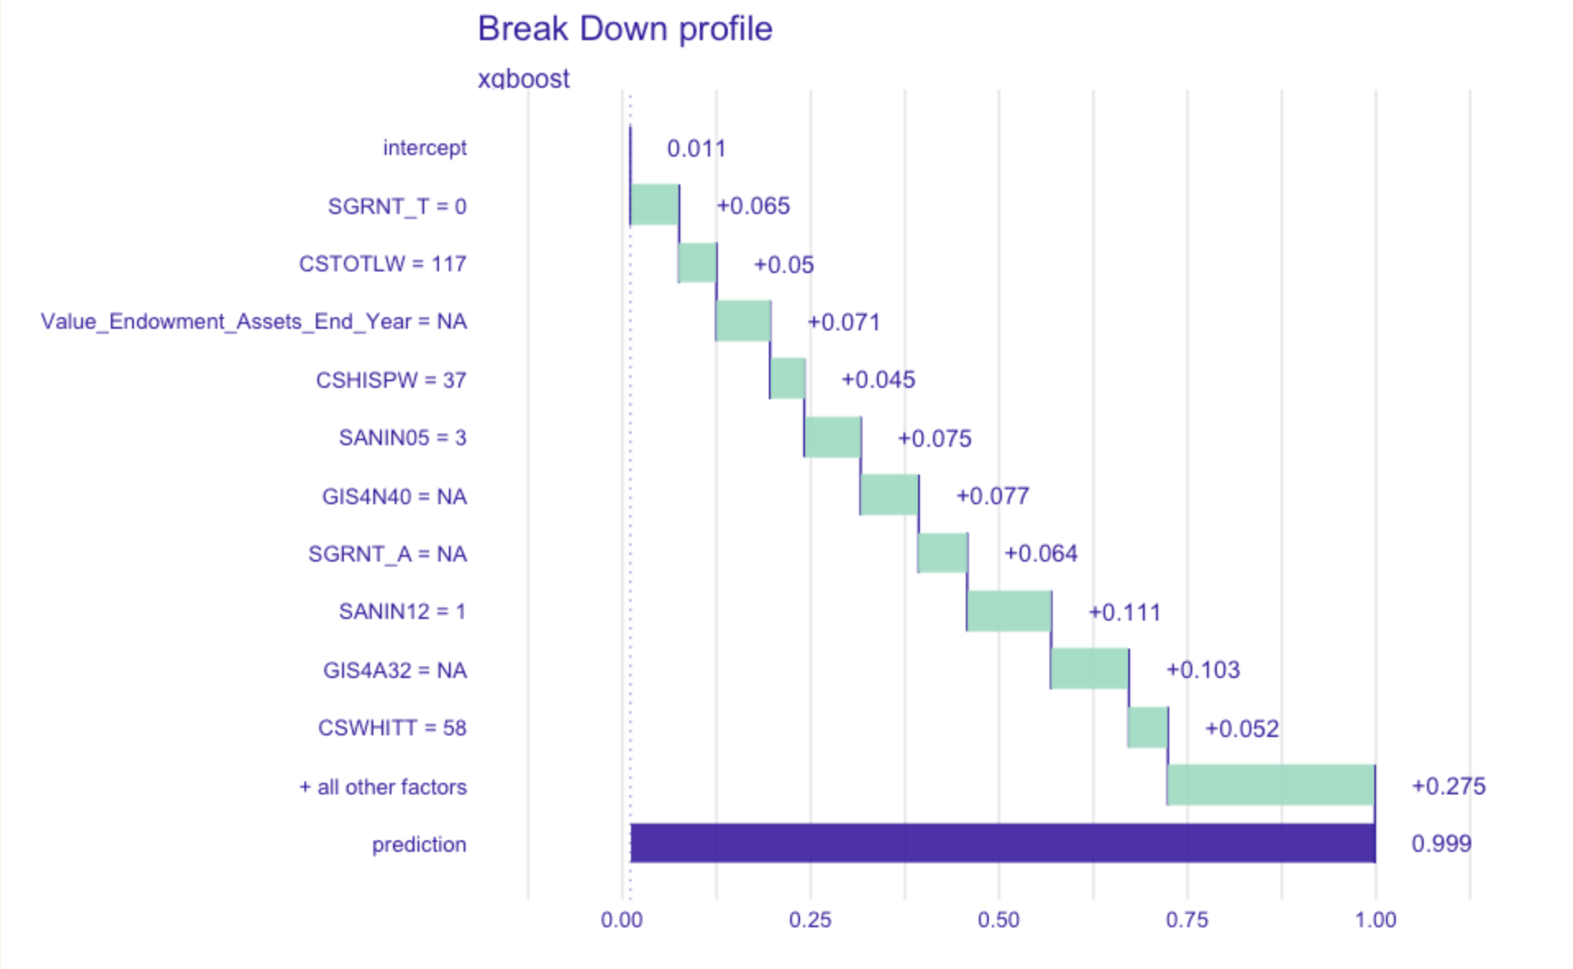
Variable Breakdown - California College San Diego
13
Predicted at a high risk of closing in 2018. Officially closed in 2021
Significant Variables:
CSWHITT - Total # of white students
GIS4A32 - Avg. Grant & Scholarship aid for lower-income students
SANIN12 - Total # of Office and Administrative Support
Using DALEX, we were able to build a “Model profile” plot for individual schools. On the plot, you can see the variables that predict for an individual school.
Notes:
Will
To increase transparency and interpretability of our model, we utilized the DALEX package to generate variable breakdown plots for individual schools. These plots help us understand how the model came to its prediction.
This example focuses on California College San Diego in 2018, which our model identified as the highest-risk institution. The school ultimately closed in 2021, falling in to our 2–4 year window.
One of the most significant predictors in this case was the number of office and administrative support staff. With only one salaried administrator reported, the model flagged this as a major concern—likely reflecting severe financial strain. This type of insight can be pivotal for identifying early warning signs and supporting Huntington’s decision-making.

Slide 14
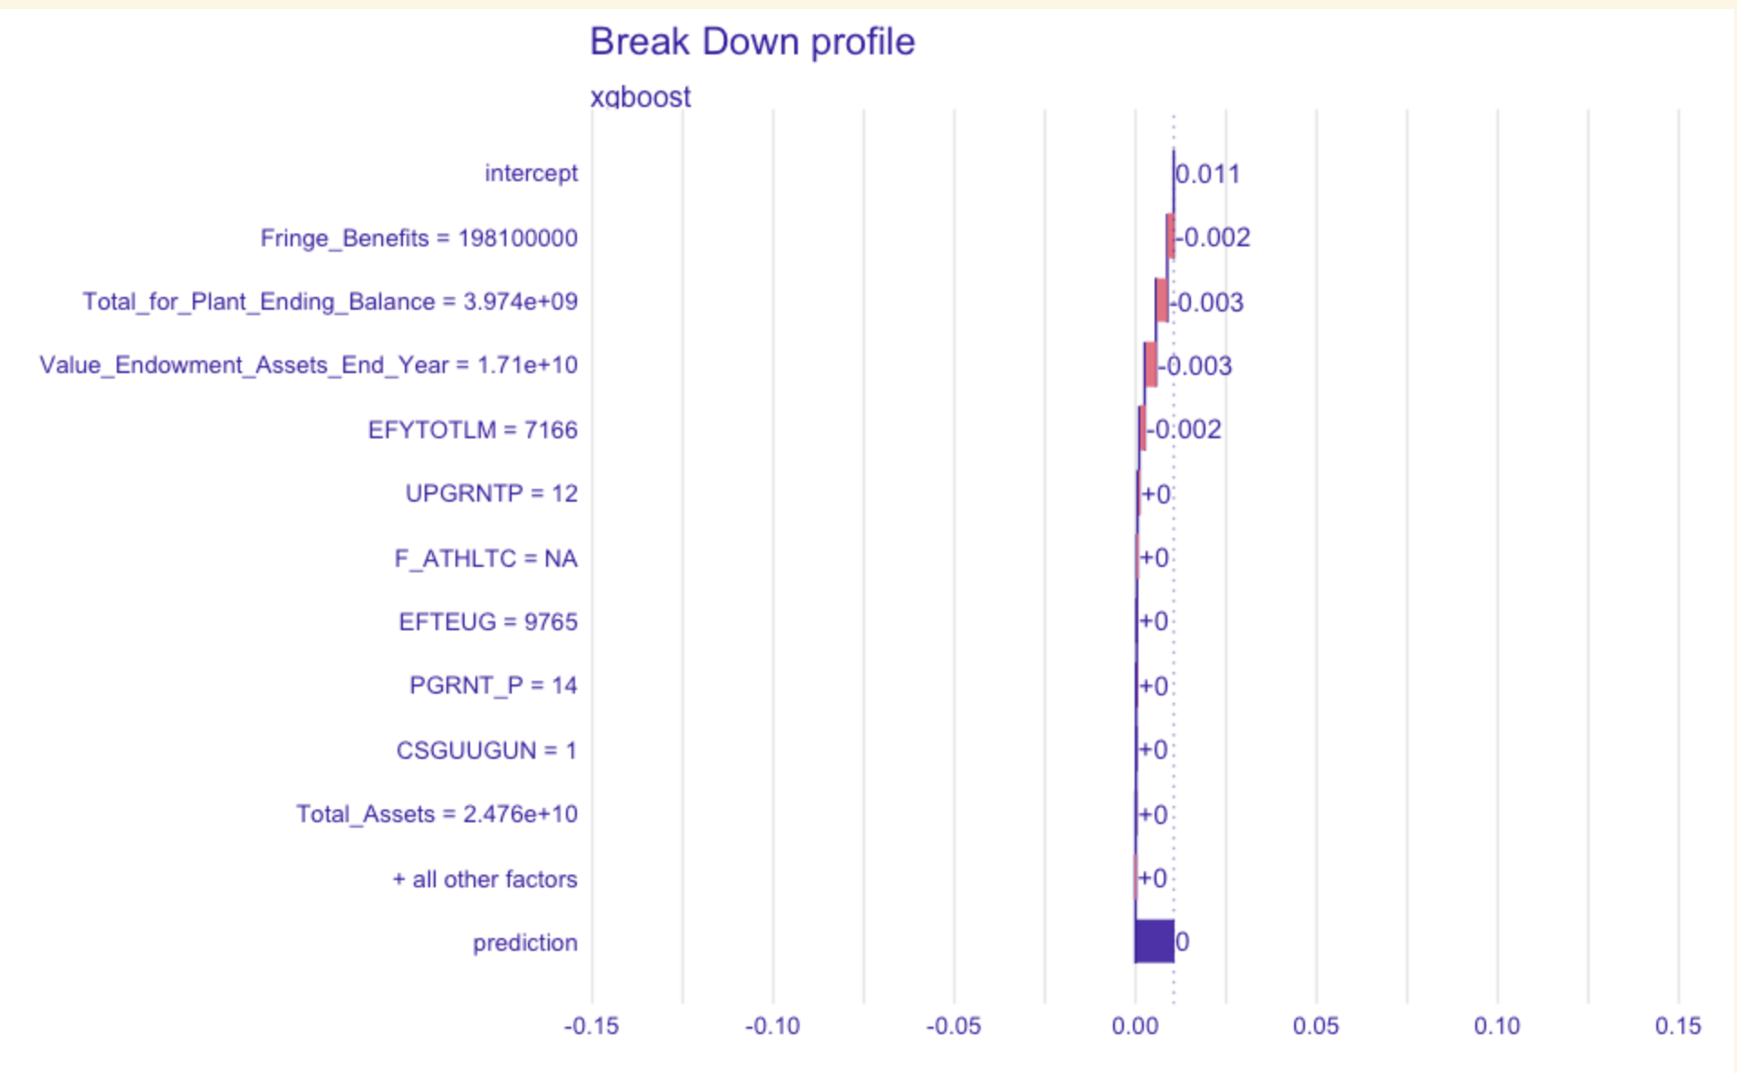
Variable Breakdown - Notre Dame
14
At no risk of closing
Notes:
Will
Now for comparison's sake here is the variable plot for the most recent year reported by Notre Dame. Notre Dame is at no risk of closing and the model accurately picked up on this mainly from the fringe benefits which include 401k, medical, and other benefits the university provides its employees and the universities endowment which is so large it had to be in sig figs.This example reinforces our model’s ability not just to identify schools at risk, but also to recognize highly stable institutions with strong financial foundations.

Slide 15

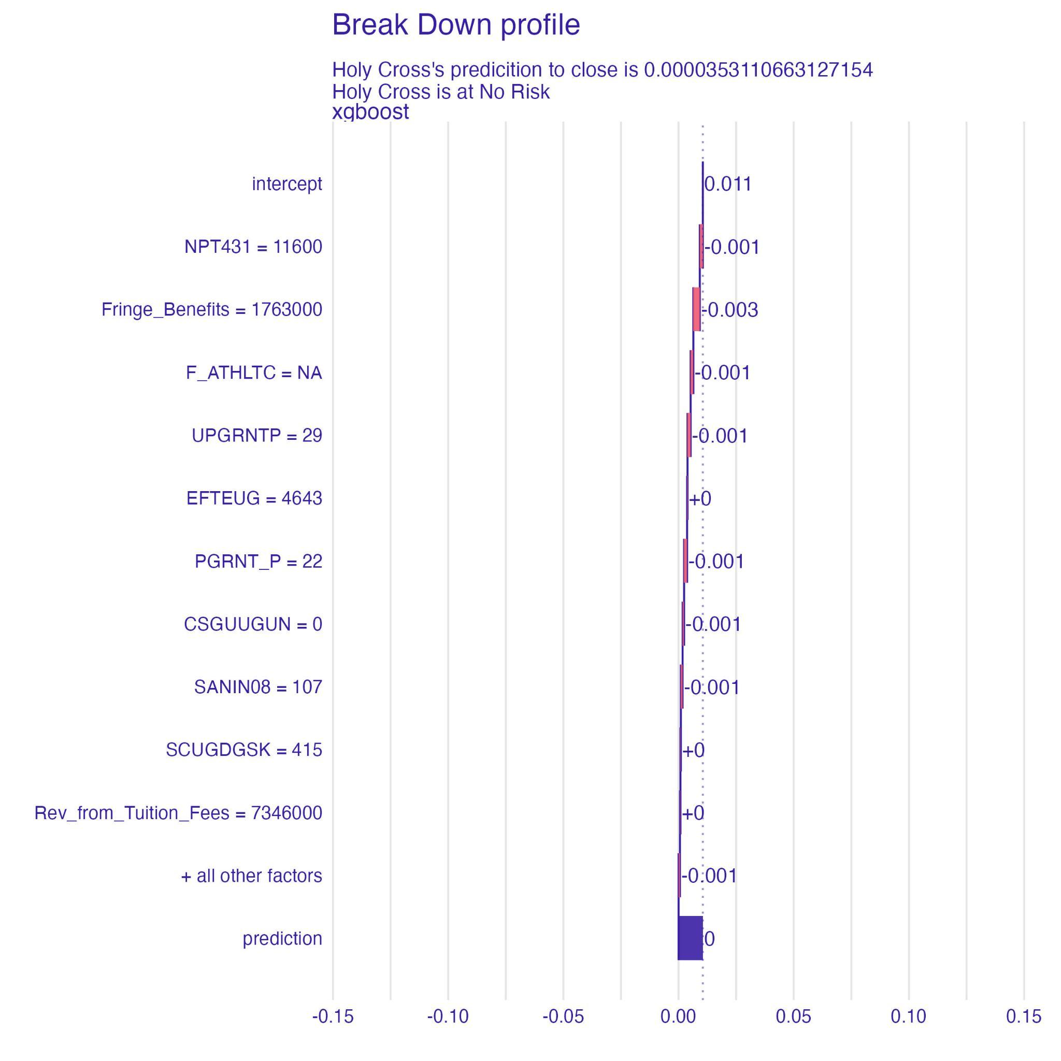


Prediction Graph Function
15
Output
Provide School Data
Upload a data frame with required institution metrics
Run the Prediction Function
Insert data into the closure_graphs( ) function for processing
The Results
Returns the prediction and variable importance plot as a JPEG.
Notes:
Will
To facilitate the use of our model we created two functions in R. First is our graph function. This function takes a data frame consisting of the school’s name and the 68 variables needed for our model and produces a DALEX variable breakdown plot that also includes the school’s prediction and risk bucket.The function can process multiple schools and automatically saves the plots as JPEG files to the user’s working directory.
These visualizations offer a clear, interpretable view of each school's situation and can play a key role in supporting data-driven decisions for Huntington.

Slide 16
Prediction Table Function
16
Output
Provide School Data
Upload a data frame with required institution metrics
 | School | Prediction | Bucket
1 | Holy Cross | 0.00000353111 | No Risk
2 | Notre Dame | 0.0000029297 | No Risk
3 | Virginia Tech | 0.0000013564 | No Risk
4 | Michigan | 0.0000013164 | No Risk
Run the Prediction Function
Insert data into the closure_table( ) function for processing
The Results
Returns the prediction and risk buckets as table sorted from highest to lowest
Notes:
Will
The second function we developed generates a prediction table. It uses the same input as the graphing function and produces a sortable table.
The table displays each school’s predicted probability of closure along with its assigned risk bucket, and is automatically sorted in descending order based on risk.
This function is useful for quickly scanning and identifying institutions that may require closer attention or intervention. It's a fast and efficient way to prioritize resources and monitor emerging risk in the college environment..

Slide 17

School Risk Warning Model Deliverables
17
To support Huntington with the use of our model, we provided a folder of deliverables including:
Function Files
(.RDS)
Function Script
(.RMD)
Excel Input Template
Notes:
Will
And to wrap up our main model we have our deliverables. We wanted to prioritize delivering a package that was practical, accessible, and easy for Huntington to implement. We provided Huntington with a folder that consists of all the necessary rds files for our functions, a sample script which facilitates the use of these functions including necessary packages and working directory set up, and finally an Excel template pre-formatted with the required column headers.
With this setup, Huntington can simply populate the template with the relevant data for any schools they wish to evaluate, allowing them to run the model and generate outputs with minimal effort. This achieved one of our goals to create a solution that is actionable and user-friendly.

Slide 18

School Closure Countdown Model Overview
18
Goal
Model
Predict how many years until a school will close
Comparing whether a school closed at the actual time it was predicted
Random Forest Classifier Model
Captures trends of failing school characteristics
‘Y2C’ Variable
Notes:
Billy
Building off of the ideas of our first model, Our second model is a multi-class classification model aimed at comparing whether a school that closed did so at the actual time it could’ve been predicted to by a model
This assessment is based on its characteristics in comparison to other failing and already failed schools, as was the case in the first model
Similarly, predicting how many years until the school will close using our ‘Y2C’ response variable.
We utilized a random forest classifier model to determine how many years from closure a school is.
By doing this, we hope to allow Huntington to further improve their assessment of potential client schools in need of support,
by allowing them to see not just how similar schools are to those that failed, but also looking at where they compare to those closed schools along that timeline

Slide 19
School Closure Countdown Model Metrics
1
19
3 Year Prediction Window:
75% accuracy for schools in any three year window
22%
75%
Exact closure :
22% of predictions pinpointed the exact closing year from 1-9
accuracy
accuracy
98.4%
Overall Accuracy:
Correctly predicted closure for 98.4% of schools (including schools which remain open)
accuracy
Notes:
Jason - The purpose of this model is to identify schools at risk of closing as early as possible.
The earlier we can identify schools trending towards closure the higher chance huntington’s financial support would be able to save them from closure.
Overall accuracy including open schools was 98.4% mostly proving the models ability to recognize patterns and differences between open and closed schools, the dataset was extremely imbalance with a couple thousand open schools weighing heavily on the accuracy of the model.
So we to created metrics based on the closed schools to test the models ability to detect differences in the schools it already classified as closed to determine the risk level of the closed schools
Exact closure
3 year sliding prediction window

Slide 20
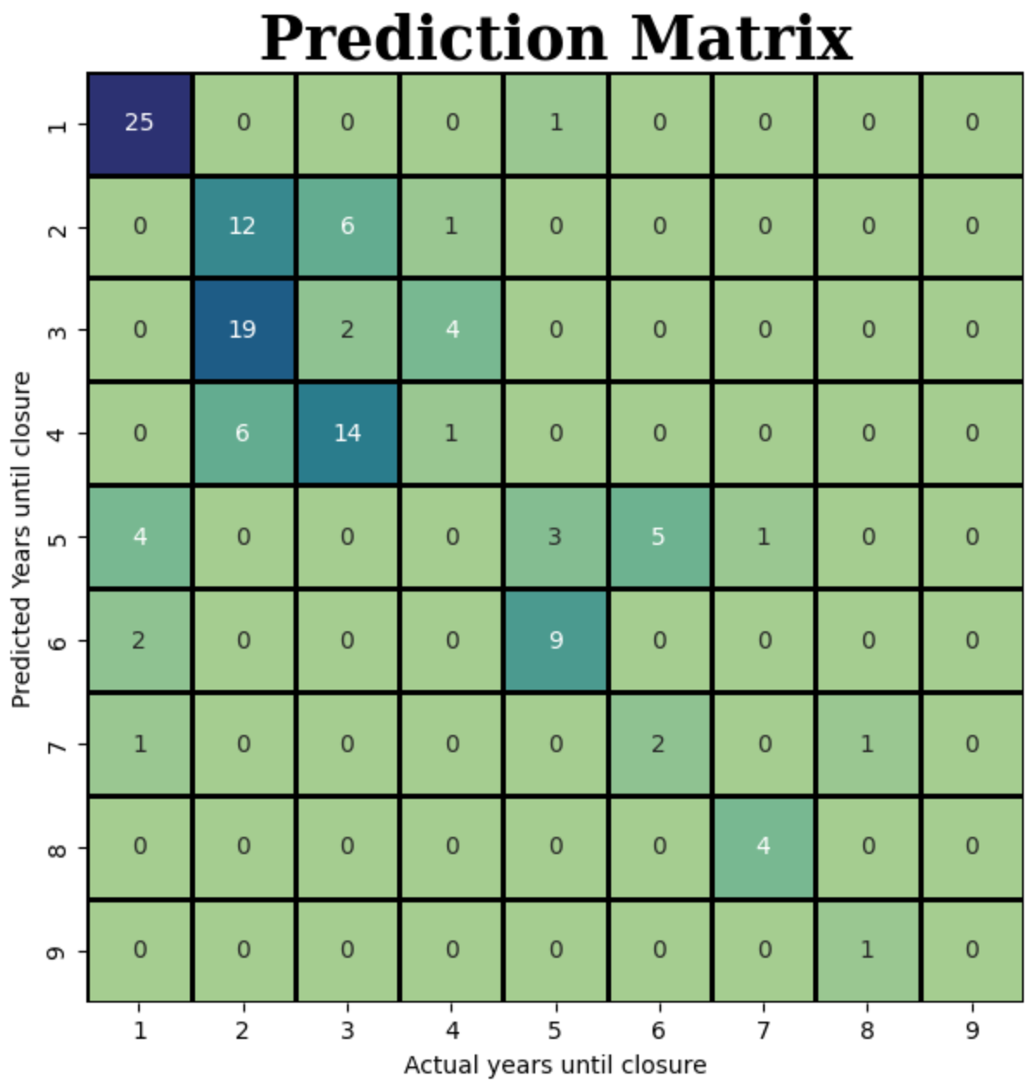
Visualization of Results
20
Removed Open Schools
Model labels schools at no risk of closing -1
Groups Schools Based on Risk
Extreme Risk, High Risk, Moderate Risk, Low Risk
Forecasting Urgency
Provides a better understanding of when to act
Notes:
Jason -
Mention removed open schools
Mention groups and dotted line where the predictions line up with the actual years to closure
Talk about different actionable steps for each group
Red - 1 year to closure, needs most financial support and business strategy adjustments,
These schools are not Huntington’s ideal client because they are extremely difficult to get back on track
Orange - 2-4 years to closure target group of model 1 , will likely need strong financial support
Yellow / Blue - might be able to benefit and save themselves from future closure with less financing and a simple strategy adjustment such as lowering tuition or offering more financial aid to attract more students

Slide 21
21
Recommendations for Each Group
Likely too late for financial support to make a difference. These schools will require the most support and a strong pivot to their business strategies.
These schools fall within the aforementioned “death spiral”. These are our primary target schools that should benefit with our financial support.
These moderate risk schools can likely benefit from a more holistic approach with a strategy adjustment and less necessary financial support
These schools are showing the earliest signs of a trend toward closing. We we can keep an eye on their trend, or provide modest support.

Slide 22
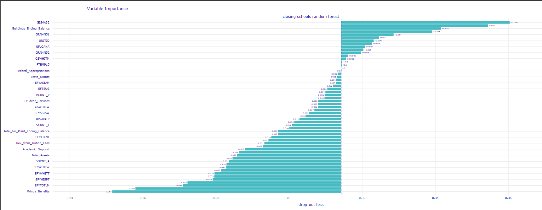
Variable Importance & Business Application
22
Identifies top predictors and quantifies their contribution to an institutions closure risk compared to the model’s baseline.
Notes:
Jason - we recommend to use this model by first finding schools that are at high or medium risk of closure, then check the variable importance that led to that school being classified as closed, and if it is a variable huntington can impact, that would become a target school for huntington to provide support. This strategy would maximize the chances hutingtons support can make a difference.

Slide 23
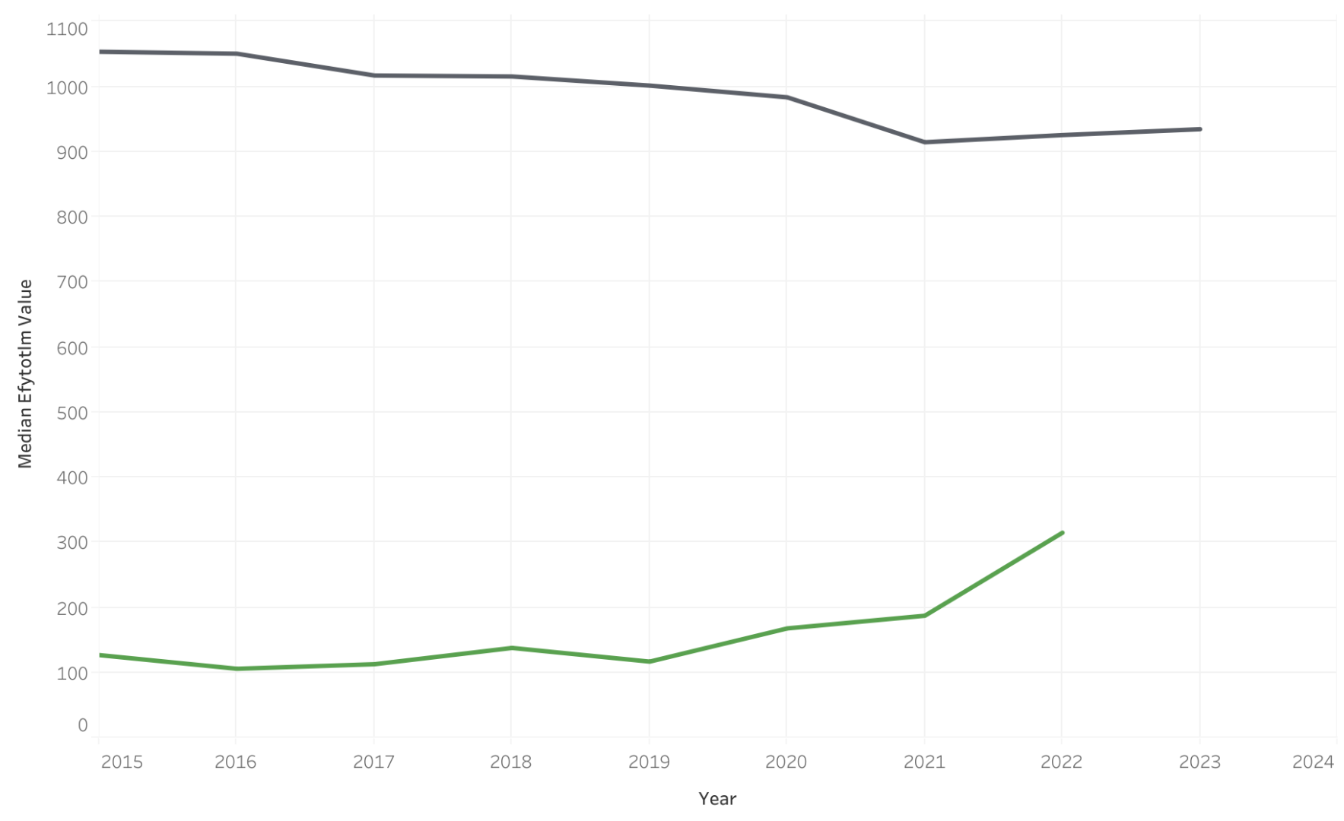
Visualizations of Variables
Median Male Enrollment by School Status
23
Open
Closed
Notes:
Ella
We wanted to visualize our important variable for easy application. The gray line are the open schools and you can see they have a much high median male enrollment as opposed to this grene line that shows the closed schools with a much lower median male enrollment.

Slide 24
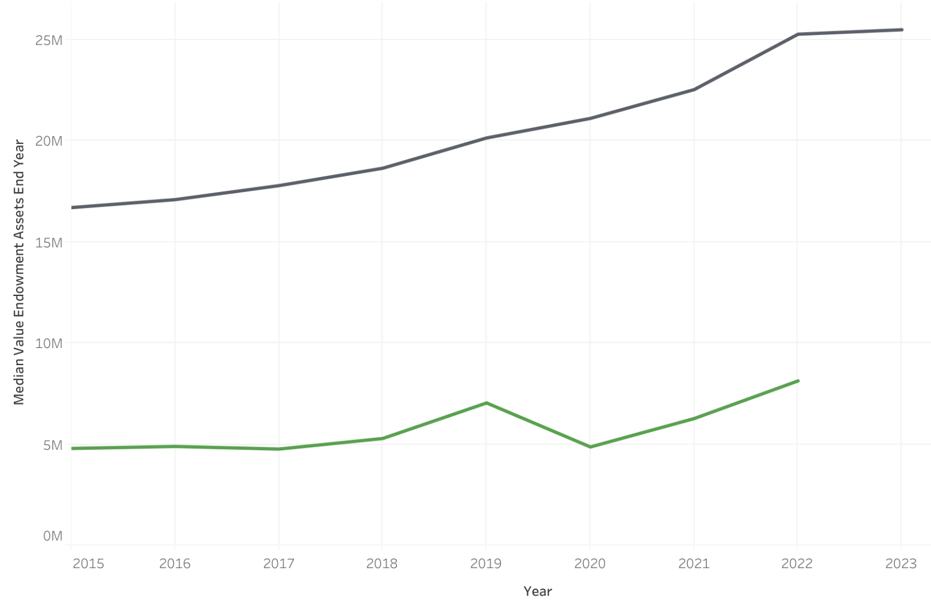
Visualizations of Variables
Median Value of Endowment Assets by School Status
24
Open
Closed
Notes:
Billy
And so here, the gray line represents open schools, which have a significantly higher median endowment value.
In contrast, the green line shows closed schools, which tend to have much lower endowment assets.
Importantly, as we can see, these closed schools were also much more vulnerable to political or social events, namely the pandemic, where you can see there was almost a 20% downturn from 2019-2020 even among this narrow group

Slide 25
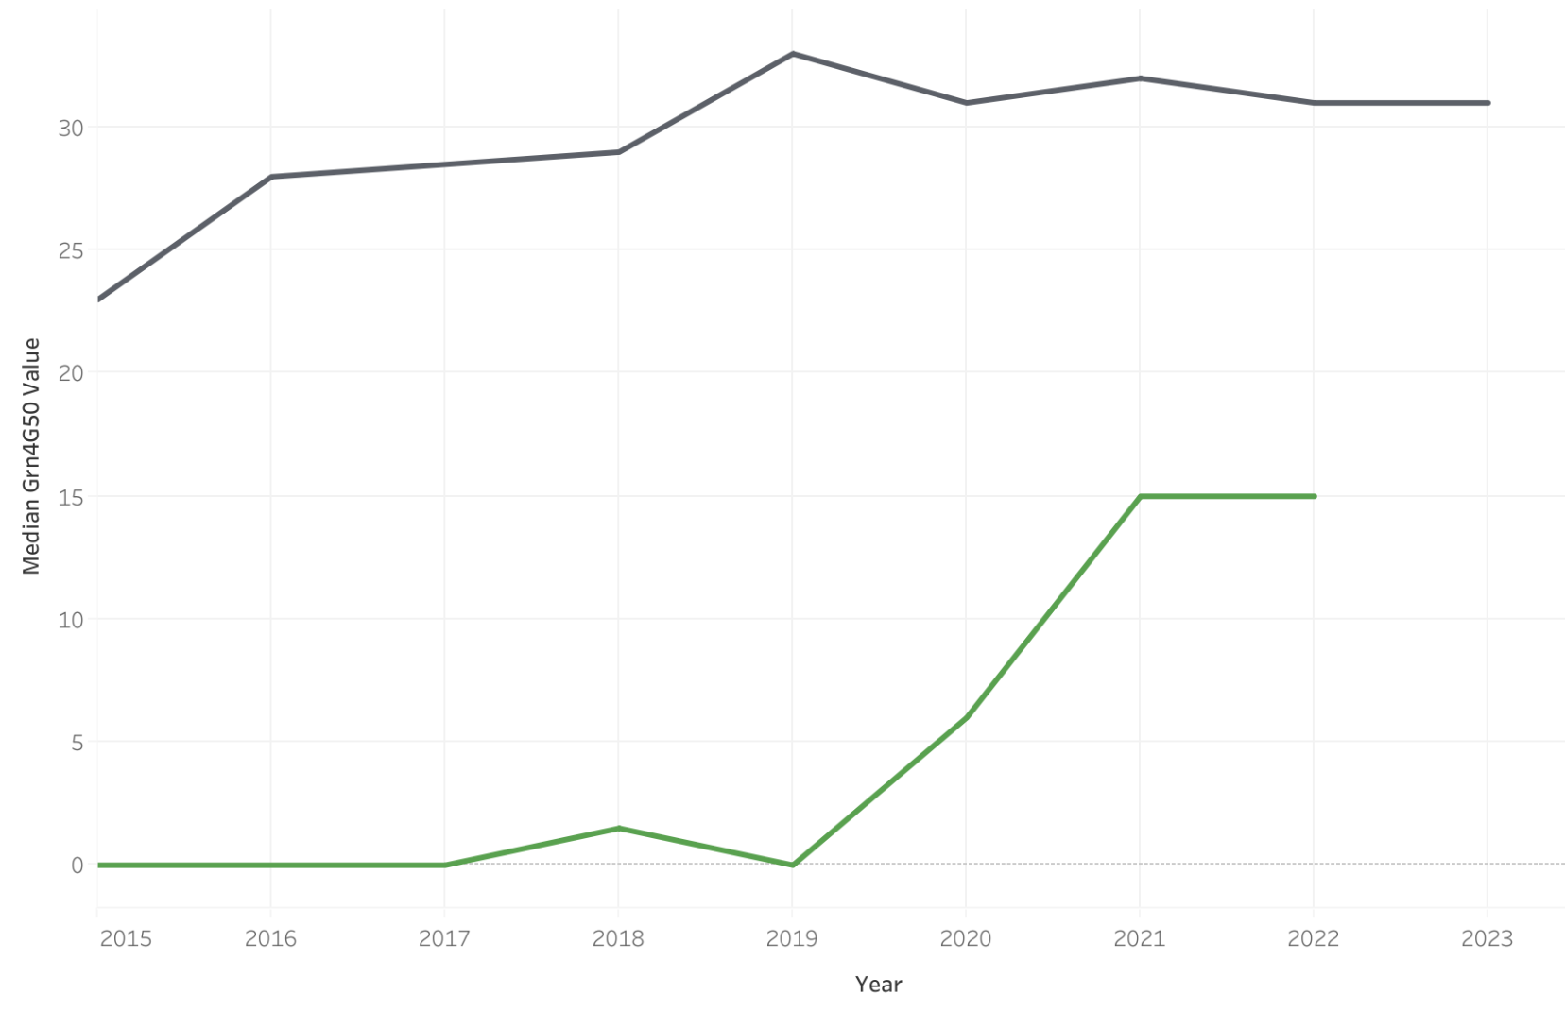
Visualizations of Variables
Median of Awarded Grant and Scholarship Aid for Higher-Income Families
Number awarded grant and scholarship aid, income level (110,001 or more), for past 2 years
25
Open
Closed
Notes:
Jason
. The gray line, representing open schools, shows a noticeably higher median award amount compared to the green line, which reflects lower awards at closed schools.
This was by far our models most important variable depicting the importance of lower costs for high income kids
The schools that closed started off offering no financial aid in more recent year those schools have attempted to pivot their strategy but it was too little too late
Tie this graph back to the 4 year death spiral and idea to make business model adjustments before it's too late with moderate risk schools

Slide 26
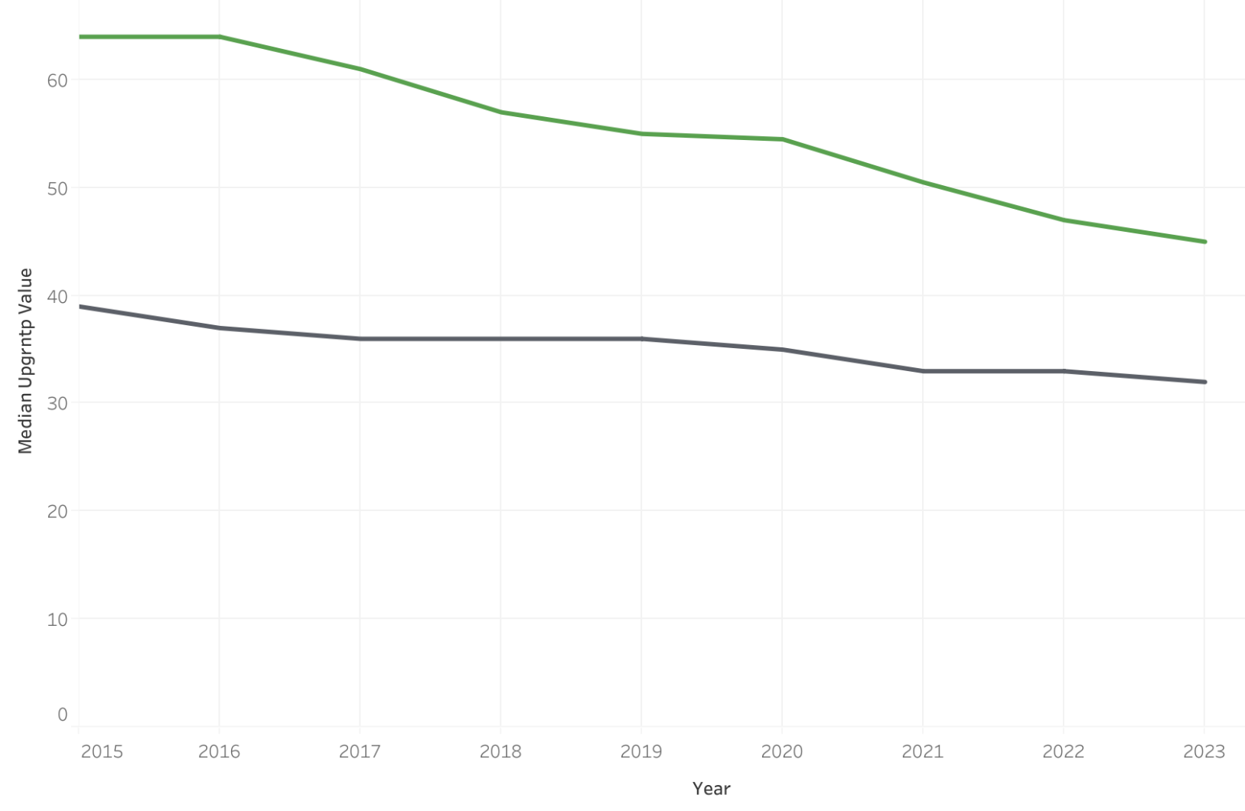
Visualizations of Variables
Median Number of Students Awarded Pell Grants by School Status
26
Open
Closed
Notes:
Billy
Here you can see the median pell grants awarded.
And in this case schools that are on track to close have more pell grant recipients. Pell grants are designed to aid students from low-income households.
This seems to indicate that the more students from struggling households that attend the schools the higher the risk of closure.
This could be for a couple reasons: These students might need more institutional aid, support services, or subsidized programs
Similarly, Pell recipients statistically have higher dropout rates due to financial, academic, or life challenges. This affects enrollment stability, which affects tuition revenue, retention metrics

Slide 27
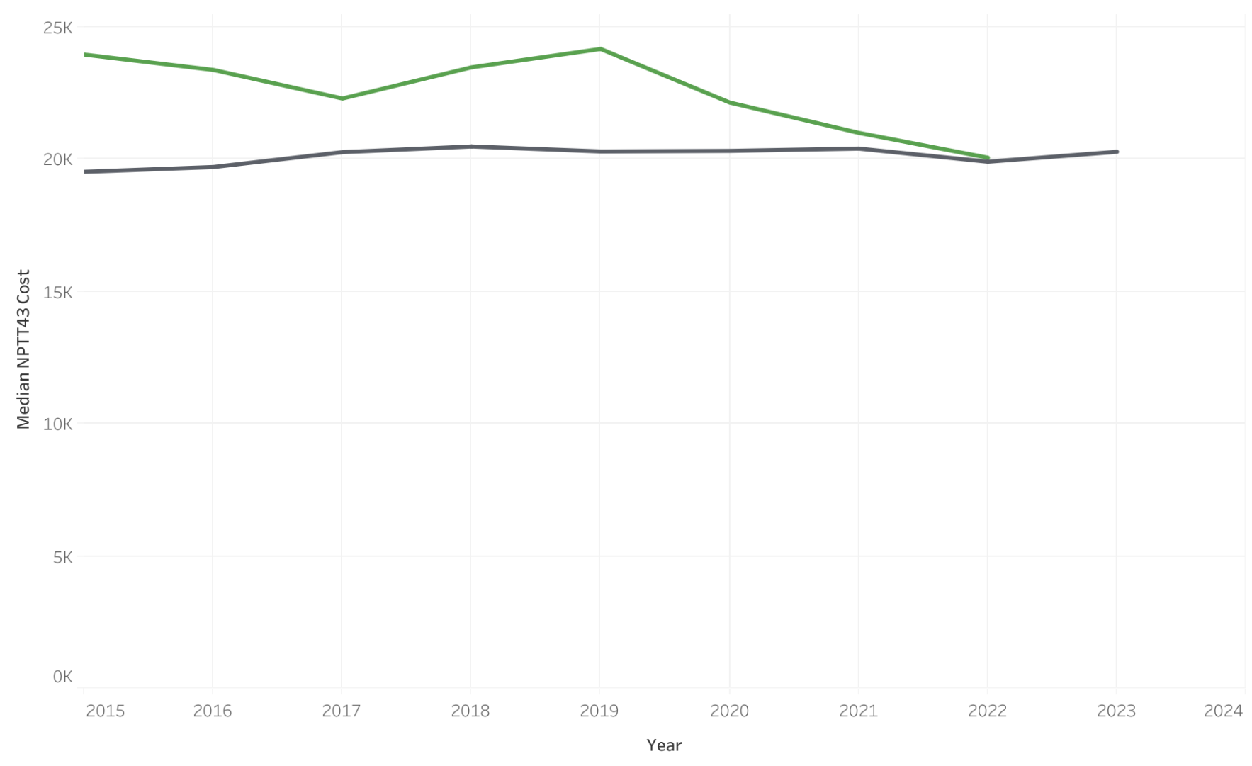
Visualizations of Variables
Median Cost for Lower-Income Families
27
Open
Closed
Notes:
Jason
Schools that closed had higher median tuition for lower income families meaning they essentially priced themseleves out of the market as students likely attended competitors with more affordable prices. On the chart you can see that closed schools eventually start trying to lower their prices to compete but at that point it is usually too late.
The gray line, showing open schools, is associated with a higher median cost. Meanwhile, the green line for closed schools reflects a lower cost burden, highlighting financial accessibility challenges among the institutions that have shut down.

Slide 28
Business Application
28
01
Upper-Middle Income Students
School’s ability to attract students capable of fully paying
A schools ability to provide for its middle-class students is a significant indicator of its financial stability.
02
Middle-Class Support
Indicator of financial stability
Having a large undergraduate base of upper-middle income students typically signals a schools ability to attract students capable of paying full or near-to-full price
.
03
Schools can respond to financial downturns
Large Enrollment
A schools ability to provide for its middle-class students is a significant indicator of its financial stability
Similarly, having a large undergraduate base of upper-middle income students typically signals a schools ability to attract students capable of paying full or near-to-full price
A large student body means a school is typically more able to respond more effectively to sharp financial downturns.
Notes:
Ella
Aside from the function that is able to predict the importance plot and risk bucket, we also found some general business implications.
The presence of upper-middle income students is a strong indicator because it means the university has students that are able to pay full tuition
Similarly, a school’s ability to provide for its middle class students is a significant indicator
Large enrollment provides buffer to better withstand certain financial hardships
These are trends we saw that Huntitngan can use when evaluating schools for need of loan assistance. With our functions, it can automate this and make it a smooth process.
These are our 3 actionable business insights for Huntington bank

Slide 29

Thank You!
29

